Slide 1

Wrapping your head around headless tables
Tanstack’s table library for React, Vue, Svelte and Solid

Slide 2
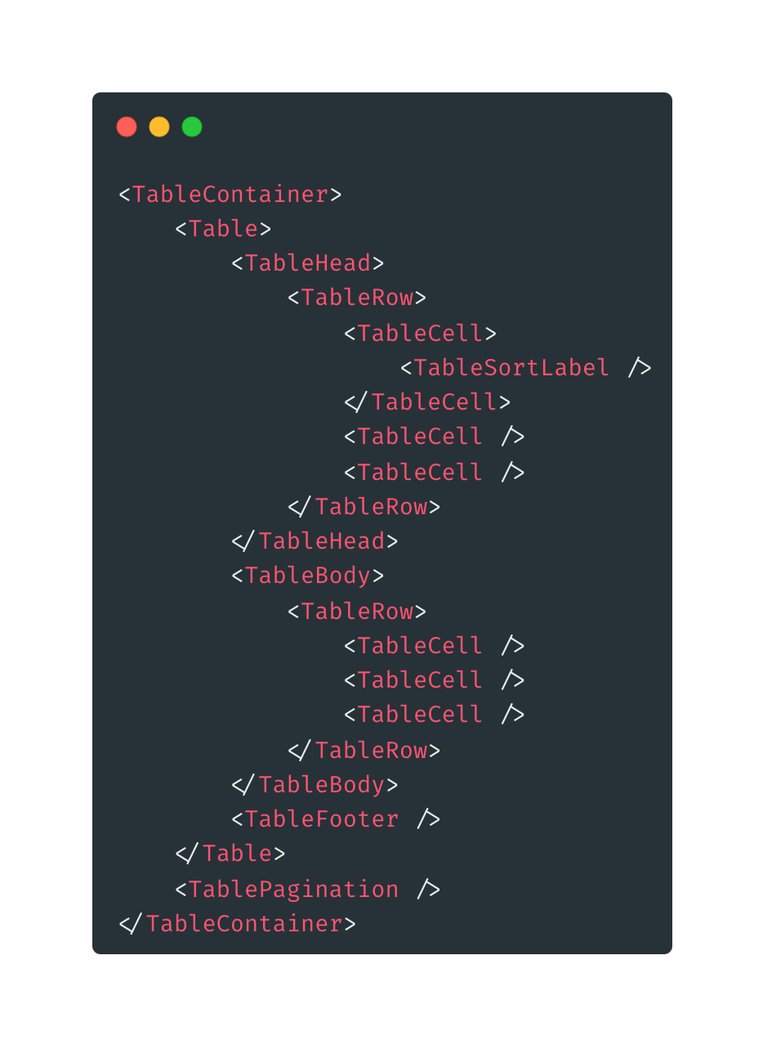

Using a component library for a table

Slide 3
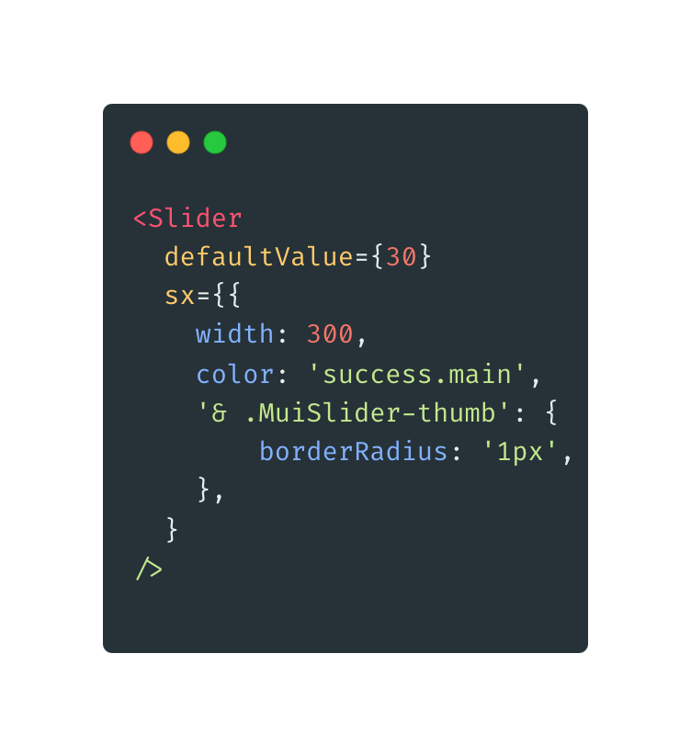
Disadvantages of component library
Restyling
What about global styles?
Overriding CSS styles?
Creating a theme?
Injecting styles?
No full control over the rendered HTML
Tree shaking?
Notes:
Overriding CSS styles can be error prone
Theme = multiple locations for styling

Slide 4


Slide 5

What is a headless table?
Collection of libraries and utilities
Provides you
Logic
State
Processing
API
Doesn’t provide you with
Markup
Styles
Pre-built implementations

Slide 6
Features of Tanstack’s headless table
Lightweight (10 - 15kb)
Tree-Shaking
Headless
Cell Formatters
Auto-managed internal state
Opt-in fully controlled state
Sorting
Multi Sort
Global Filters
Columns Filters
Pagination
Row Grouping
Aggregation
Row Selection
Row Expansion
Column Ordering
Column Visibility
Column Resizing
Virtualizable
Server-side/external Data
Nested/Grouped Headers
Footers

Slide 7

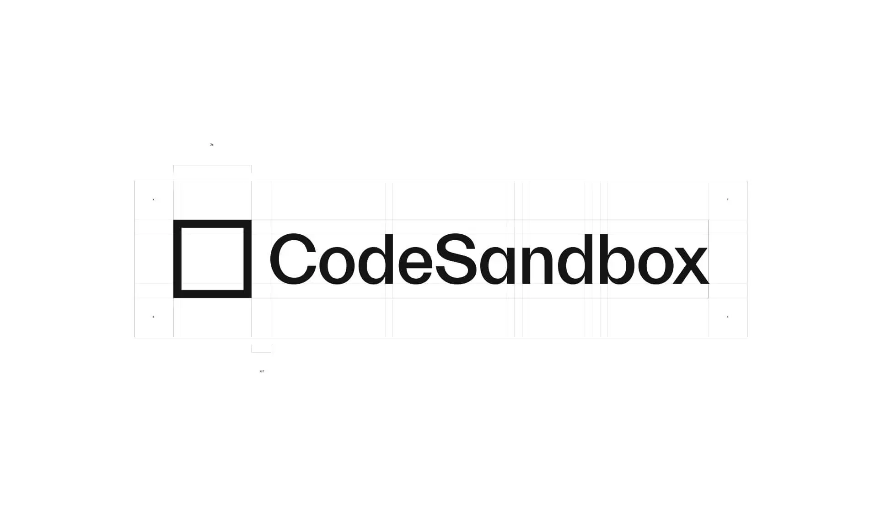
Some live code…

Slide 8

Is your mind blown?!

Slide 9
Resources
https://tanstack.com/table/v8
https://github.com/TanStack/table
https://google.com
https://codesandbox.io/p/github/ElkeCodes/Tanstack-Table-Example/main?file=/src/main.tsx
https://github.com/ElkeCodes/Tanstack-Table-Example
https://mui.com/material-ui/customization/theme-components/#theme-style-overrides
https://knowyourmeme.com/
https://tanstack.com/table/v8/docs/examples/react/filters
https://tanstack.com/table/v8/docs/examples/react/pagination
https://tanstack.com/table/v8/docs/examples/react/sorting

